Slide 1
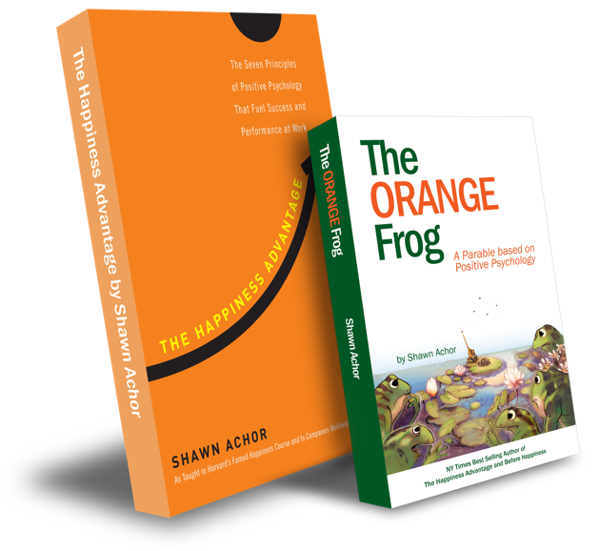
The Happiness Advantage
and
The Orange Frog
By Shawn Achor

Slide 2
High School Week Three
Notes:
BookK: https://www.orangefrogschools.com/high-school/ofbook

Slide 3
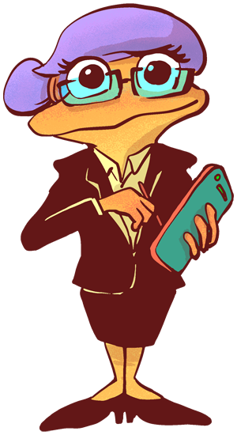
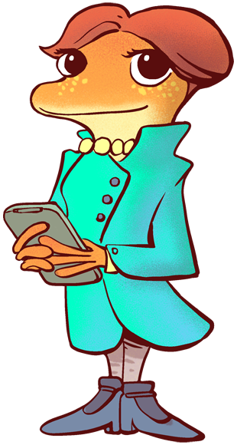
The Orange Frog
Learning Objective:
I can use a higher order of thinking to develop helpful practices
I will complete an interactive tool in an attempt to broaden my knowledge of what it means to be helpful
Notes:
Standard:
Essential Concept and/or Skill: Communicate and work productively with others emphasizing collaboration and cultural awareness to produce quality work.
Interact positively as a team member.
Cooperate with others in a group setting.
Generate ideas with group members.
Are active listeners.
Read and understand information in a variety of forms.
Express ideas.
Skill:
Active listening, express ideas
Allow Spark to read pages 13-18 for the students or read to them.
https://www.orangefrogschools.com/elementary/ofkidsbook

Slide 4
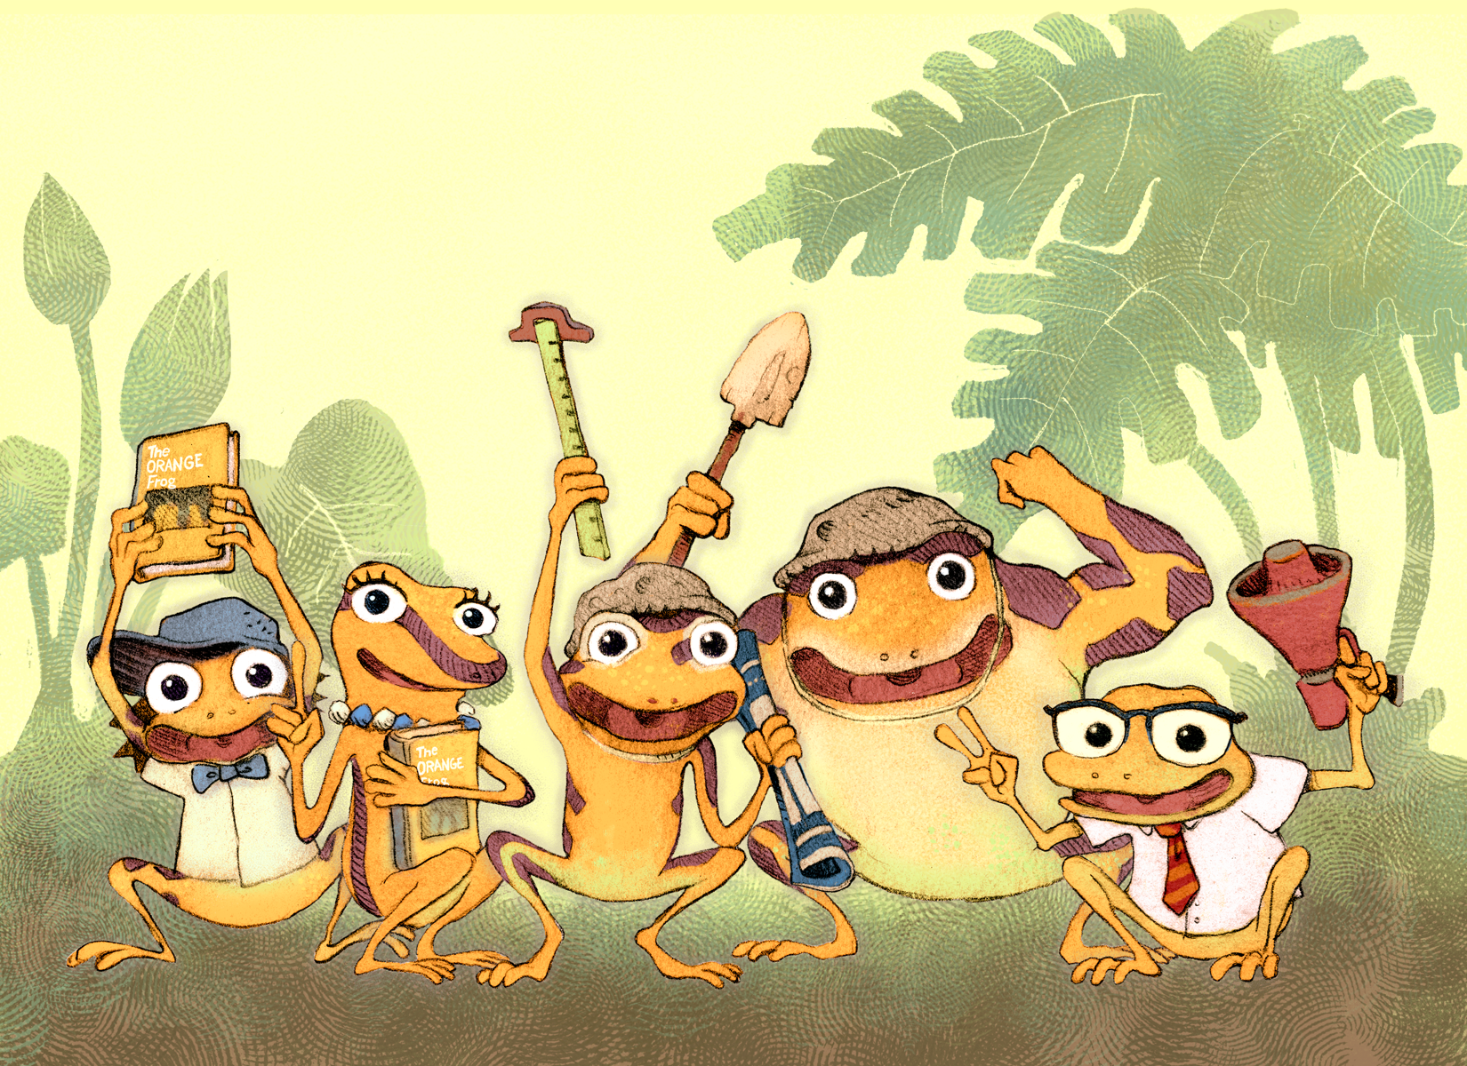
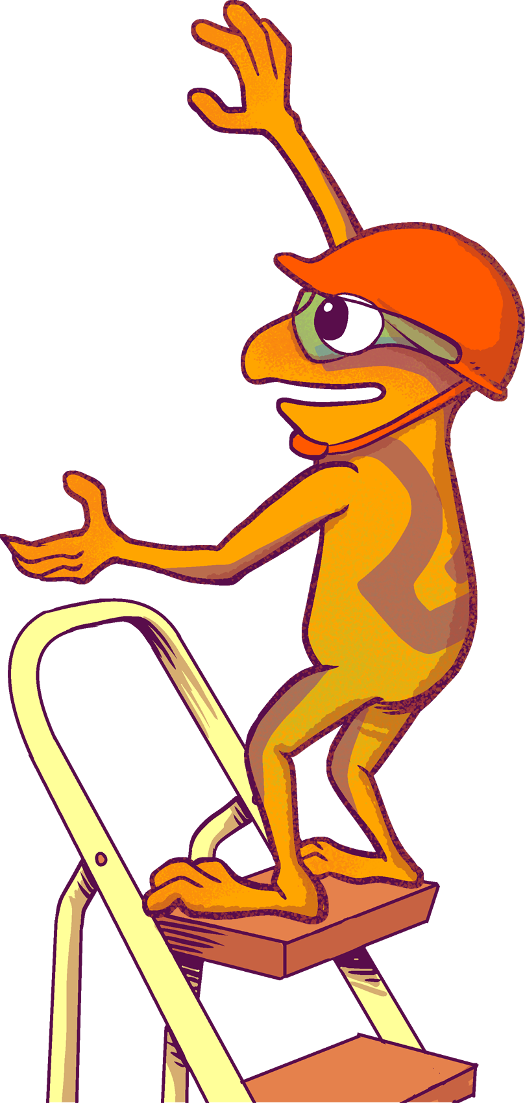
Skills
Listen actively
Express ideas

Slide 5
Opening Question
What do you remember about the story we read last week?

Slide 6
Thoughts
We learn early on in the book, that Spark becomes Orange, knows that he wants to remain Orange, and decides to figure out how to do just that.
Spark realizes that the most Orange he has ever been was when he was helping others. Spark starts to do experiments to decide what creates his stunning Orange complexion.

Slide 7
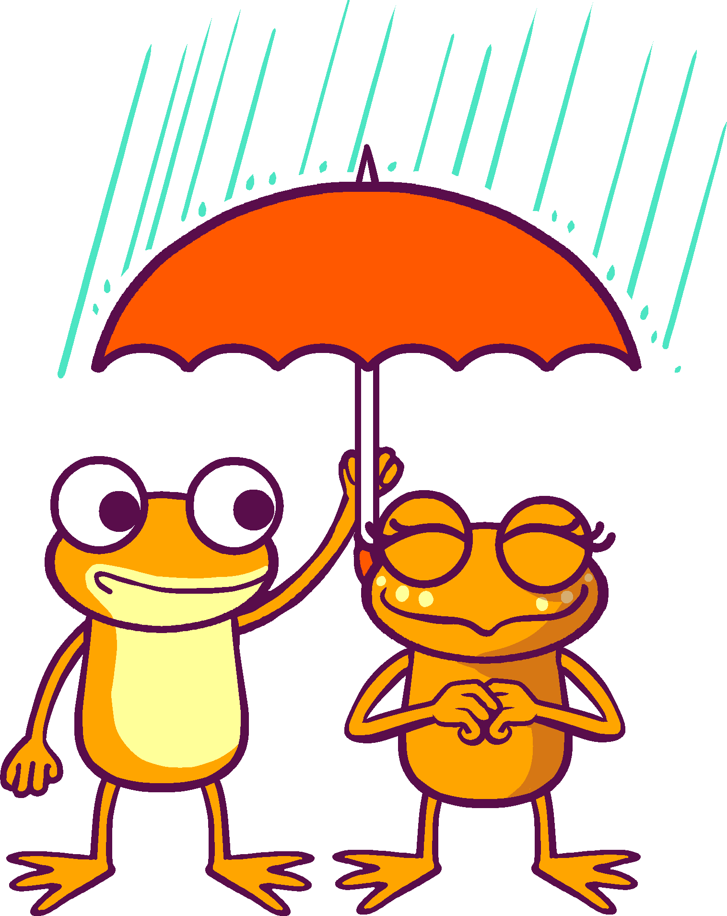
Action
Be mindful. The thing that Spark initially feels makes him the most Orange is when he helps others. We are going to dig pretty deep into a structure that reflects what it looks like to be helpful, and how it affects others. We will be working with an interactive notebook. Has anyone done this?

Slide 8
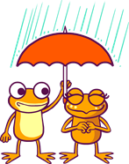
Activity
Notes:
You can either use this as a group activity and share on a projector or print out copies provided on the website for students to cut and paste the pictures on their own.
Google Classroom Link for Notebook:
https://www.orangefrogtraining.com/files/HS%20-%20OF%20-%20Wk3%20-%202.DigitalNotebook.pptx
Printable Version Link:
https://www.orangefrogtraining.com/files/HS%20-%20OF%20-%20Wk3%20-%202.DigitalNotebook%20(Print).pdf

Slide 9
Questions
What is the significance of Spark’s color changing with his mindset?
What does the spreading of orange amongst the Frogs show us about the influence of others?
What does it mean to “choose to be orange”?
Notes:
Spark’s color changing with his mindset is a metaphor that demonstrates the importance of what we think and what we do.
Happiness is contagious, but so is negativity. The company we keep is important.
Happiness is something that comes from within.

Slide 10
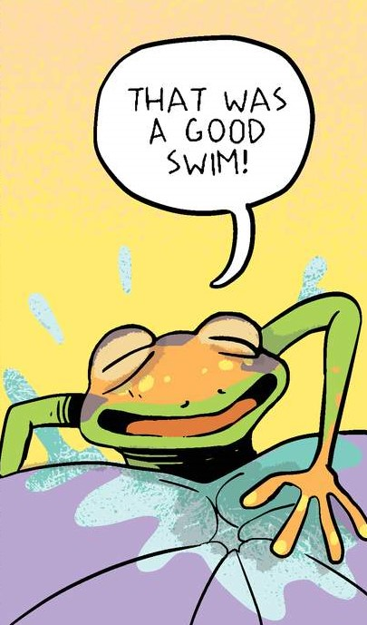
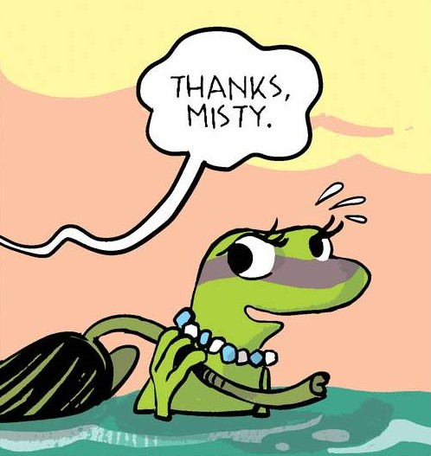
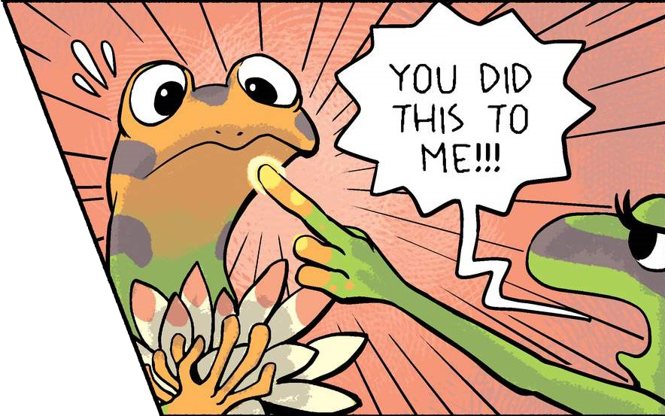
Bonus Questions
What was one of the first things Spark does to be orange after he makes a conscious decision?
What does Misty do for Plop that makes her feel good about herself?
What was wrong with Misty’s hand?
Who does Misty think did “this” (meaning the orange) to her?

